Slide 1
Keynes’s Theory of Money: Liquidity Preference Theory
Professor Ravi Kiran

Slide 2
Keynes’s Theory of Money: Liquidity Preference Theory
In 1936, economist John M. Keynes wrote his influential book, The General Theory of Employment, Interest Rates, and Money.
In this book, he developed his theory of money demand, known as the liquidity preference theory, which is a theory of money demand that emphasized the importance of interest rate.
According to Keynes an individual’s total wealth consisted of money and bonds.
For Keynes, rate of Interest is the reward for 'parting with liquidity'.

Slide 3
Keynes’s Theory of Money: Liquidity Preference Theory
Keynes used the term ‘bonds’ to refer to all risky assets other than money.
So money holding was the only alternative to holding bonds. And the only determinant of an individual’s portfolio choice was the interest rate on bonds.
This would affect an individual’s decision to divide his portfolio into money and bonds.
To Keynes, it costs money to hold money and this is the opportunity cost of holding money.
At high rates of interest an individual loses a large sum by holding money or by not holding bonds.

Slide 4
Keynes’s Theory of Money: Liquidity Preference Theory
At high rate of interest the opportunity cost of money holding (in terms of forgone interest) is high.
At a high rate of interest future capital gain on bonds is likely due to a fall in the rate of interest in future. It is because there is an inverse relation between the rate of interest and the price of old bonds.
Thus if the present rate of interest is high, people will expect it to fall in near future, in which case they will expect to make capital gain.

Slide 5
Keynes’s Liquidity Preference Theory
In his theory, Keynes believed that there are three motives for individuals to hold money:
The transaction motive,
The precautionary motive, and
The speculative motive.

Slide 6
Transaction Motive
Keynes agreed with the classical theory that money is used as a medium of exchange.
So people’s demand for money is for the purpose of transactions.
As income rises, people have more transactions and will hold more money.

Slide 7
Precautionary Motive
In addition to holding money to carry out current transactions, Keynes observed people hold money to be used in future for unexpected needs and emergencies.
Since the amount of money held depends on the amount of transactions people expect to make, money demand is again expected to rise with income.

Slide 8
Speculative Motive
Keynes suggested that people also hold money as a store of wealth.
Because wealth is tied closely to income, the speculative motive for money demand is related to income.
Keynes assumed that people stored wealth with either money or bonds.

Slide 9
Keynes’s Liquidity Preference Theory
When interest rates are high, rate would then be expected to fall and bond prices would be expected to rise.
So bonds are more attractive than money when interest rates are high.
When interest rates are low, they then would be expected to rise in the future and thus bond prices would be expected to fall.
So money is more attractive than bonds when interest rates are low. So under the speculative motive, money demand is negatively related to the interest rate.

Slide 10
Demand for Money
Transactions motive (arising from medium of exchange function):positively related to Y
Precautionary motive: positively related to Y.
Speculative motive (arising from store of wealth function): Negatively related to Rate of interest (i)

Slide 11
Demand for Money
Money demand reflects how much wealth people want to hold in liquid form-as money.
For simplicity, suppose household wealth includes only two assets:
  Money – liquid but pays no interest
  Bonds – pay interest but not as liquid
A household’s “money demand” reflects its preference for liquidity.
The variables that influence money demand:
Y, and i.

Slide 12
Equilibrium
Interest
Rate
Money Supply
Money Supply and
Money Demand are
equal at the equilibrium
interest rate.
IE
Money Demand
Quantity of Money
Q^{Fixed}
Notes:
22
22
22
20

Slide 13
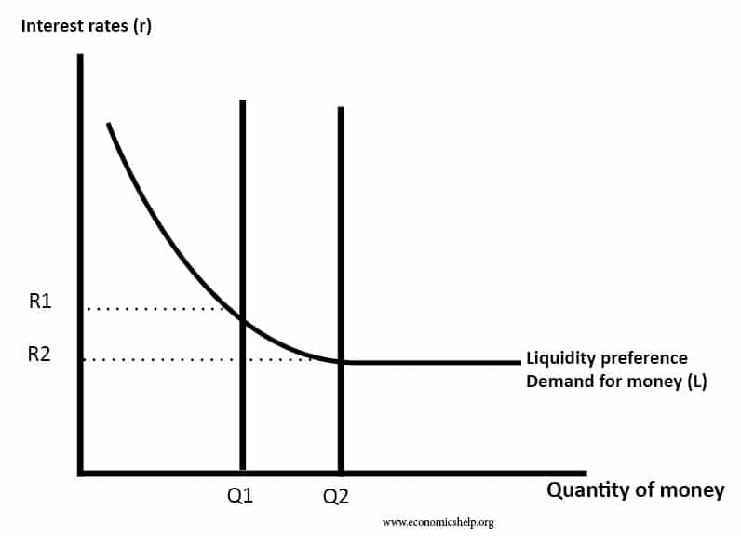
Keynes Theory
Keynes said that money is the most liquid asset and the more quickly an asset can be converted into cash, the more liquid it is.
The supply of money is determined by the central bank or such agencies designed for it whereas the demand for money arise based on the preference of people to hold money in liquid form.

Slide 14
Keynes Theory
Keynes also suggested the possibility of the existence of what is called the liquidity trap. This refers to a situation when at a certain rate of interest the (speculative) demand for money becomes perfectly elastic.
This will come about when at that rate all the asset holders turn bears, so that none is willing to hold bonds and everyone wants to move into cash.

Slide 15

Thank You

